Slide 1
Why vaccinate your kids?

Slide 2
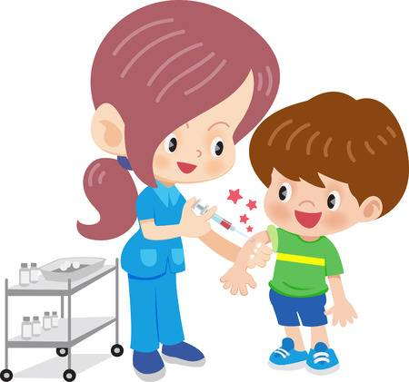
As a parent, you may not like seeing your baby or child being given an injection.
But vaccinations will help to protect them against a range of serious and potentially fatal diseases.
There are 3 good reasons to have your child vaccinated:
Vaccinations are quick, safe and extremely effective
Once vaccinated, their body can fight diseases better
No vaccination results in higher risk of becoming unwell
However, there will always be some children who are unprotected because:
They cannot be vaccinated for medical reasons
They're too young to be vaccinated
The vaccine does not work (although this is rare)
But if more parents have their children vaccinated, more children in the community will be protected against an illness, such as a measles outbreak
Can you overload a child's immune system?
Studies have shown that vaccines do not weaken a child's immune system.
As soon as a baby is born, they come into contact with a huge number of different bacteria and viruses every day, and their immune system copes well.
The bacteria and viruses used in vaccines are weakened or killed, and there are far fewer of them than the natural bugs that babies and children come into contact with.

Slide 3
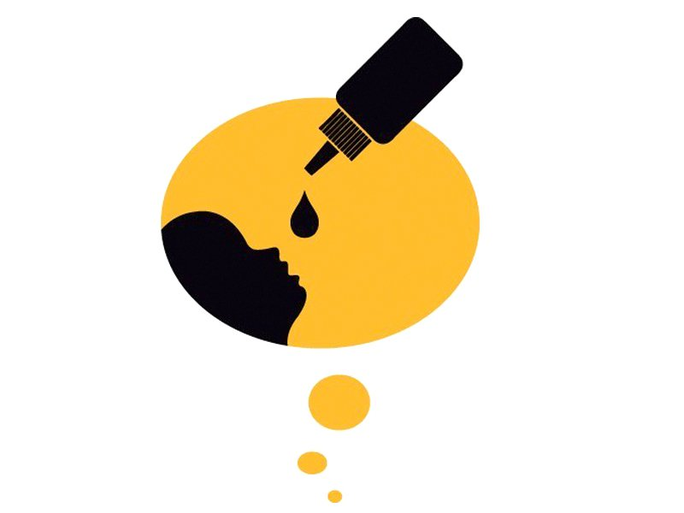
GOV.UK
Public health matters
Why vaccinate?
After clean water, vaccination is the most effective public health intervention in the world for saving lives and promoting good health. Globally, we have one of the best immunisation programmes in the UK and we’re always at the forefront of rolling out new programmes when the best vaccination is available. This has definitely been the case over the past year – we introduced an impressive four new vaccination programmes in 2013/14 and are continuing to look at new opportunities.
One of the new vaccines introduced last summer is for rotavirus. Rotavirus is the most common cause of vomiting and diarrhoea (in infants and young children. Prior to this, nearly every child will have had at least one episode of rotavirus gastroenteritis by five years of age. In children younger than five years in the UK, this infection has been responsible for around :
140,000 young children visiting the GP
14,000 babies and young children being admitted to hospital every year
37,000 NHS Direct calls
30,000 A&E attendances
The rotavirus vaccination programme began on 1 July 2013 when children under four months were routinely vaccinated against this highly infectious illness. It is administered as a droplet into babies’ mouths during their two- and three-month vaccination appointments.
Lab reports show there were 70 per cent fewer cases of rotavirus during the same period when compared to the average over the last 10 seasons.
Notes:
Why vaccinate?
Posted by:Joanne Yarwood, Posted on:1 May 2014 - Categories:Health Protection, Immunisation and vaccination, Protecting the country's health
After clean water, vaccination is the most effective public health intervention in the world for saving lives and promoting good health. Globally, we have one of the best immunisation programmes in the UK and we’re always at the forefront of rolling out new programmes when the best vaccination is available. This has definitely been the case over the past year – we introduced an impressive four new vaccination programmes in 2013/14 and are continuing to look at new opportunities. Earlier this year the Joint Committee on Vaccination and Immunisation (JCVI) recommended that we introduce a cost effective vaccination against meningitis B, and we look forward to hearing more about how this might be possible.
So how do we choose what to vaccinate against?
Diseases our grandparents used to fear and that were the norm in the UK are now in most cases rare and in some cases consigned to the past entirely. Polio was a real threat until 50 years ago and caused significant ill health and permanent disability to individuals struck with the infection, but now in the UK it is completely eradicated. This is entirely due to a successful vaccination programme.
However, the move toward eradicating various infections as a public health problem is not just as simple as producing a new effective vaccination. It only works if the uptake of the new vaccination is high, so we rely on the trust of people to accept a vaccination when it is offered.
One of the new vaccines introduced last summer is for rotavirus. Rotavirus is the most common cause of vomiting and diarrhoea (gastroenteritis) in infants and young children. Prior to the vaccination programme, nearly every child will have had at least one episode of rotavirus gastroenteritis by five years of age. In children younger than five years in the UK, this infection has been responsible for around 140,000 young children visiting the GP and 14,000 babies and young children being admitted to hospital every year, as well as 37,000 NHS Direct calls and 30,000 A&E attendances.
The rotavirus vaccination programme began on 1 July 2013 when children under four months were routinely vaccinated against this highly infectious illness. The vaccine is administered as a droplet into babies’ mouths during their two- and three-month vaccination appointments.
We are extremely pleased that so far the preliminary data show an excellent start to the uptake of the rotavirus vaccine and we are encouraged that this spells really good news for the future. From July 2013 to March 2014, 93 per cent of children in the survey we conducted had received the first dose of rotavirus and 88 per cent had completed the two dose course. The excellent news is that lab reports show there were 70 per cent fewer cases of rotavirus during the same period when compared to the average over the last 10 seasons. This graph shows the huge impact this vaccine has already had:

Slide 4
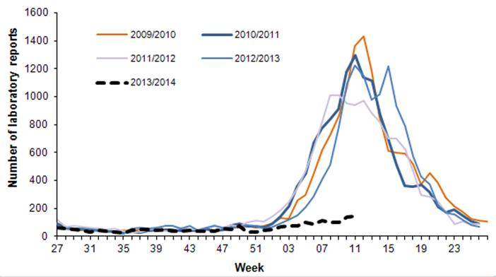
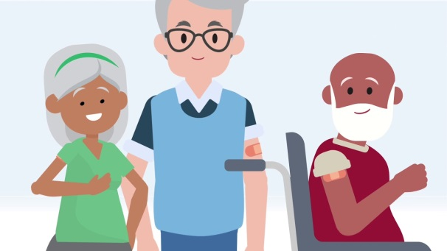
Another example of a new vaccine introduced in 2013 is shingles. The illness usually lasts two to four weeks, the first sign of the condition being a tingling sensation in the affected area, followed by pain and then a rash, usually on the chest. This mainly affects older adults.

Slide 5
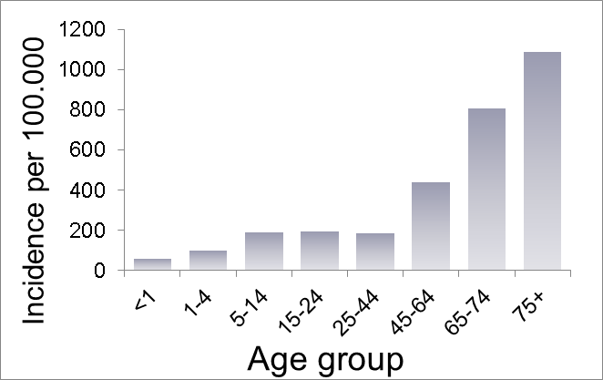
Shingles can be very serious – leading to intractable pain and, in a few cases, death.
So far, nearly half the people eligible for the vaccine have been immunised. We are continuing to support health care workers to promote this new vaccine to the 70 and 79 year-olds who are eligible.

Slide 6
Benefits of immunisation
Immunisation is a way of protecting against serious diseases. Once we have been immunised, our bodies are better able to fight these diseases if we come into contact with them.
How does immunisation help eliminate disease?
Some diseases that are caused by viruses can't be cured with antibiotics. The only way to control them is by immunisation.
With continued immunisation programmes, such diseases may no longer be a threat.
Successful examples of immunisation bringing diseases under control include smallpox and polio, which were once common in the UK, but are no longer a threat.
The WHO declared smallpox wiped out in December 1979 thanks to a focused effort to immunise against the disease across the world. It declared Europe free from polio in 2002.

Slide 7
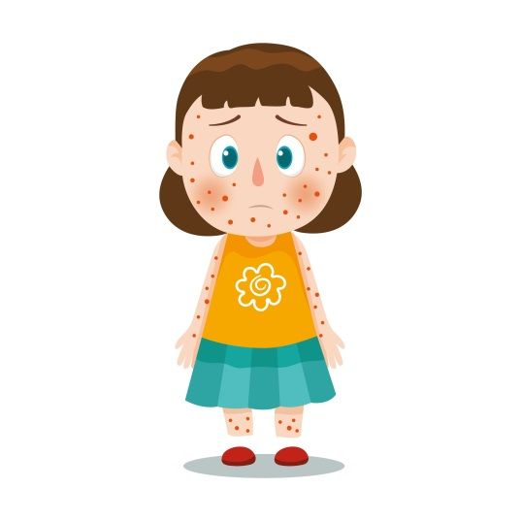
Why immunise?
Immunisations have led to a huge decrease in childhood deaths.
The World Health Organization (WHO) states:
'The 2 public health interventions that have had the greatest impact
on the world's health are clean water and vaccines.'
Benefits for you
Children are exposed to many risks, including infections. Most will cause mild illnesses but can still result in severe illness, disability and at times, death.
Before vaccines, many children in the UK died from diseases such as whooping cough, measles and polio. Despite successful immunisation programmes, the diseases that vaccines protect against do still exist.
The benefit of immunisation is that your child has the best possible protection against dangerous diseases.
Benefits for us all
When your child is immunised they're helping to protect the health of the whole community.
When enough people are immunised against an infection, it's more difficult for it to be spread to those who are not immunised. This is called 'herd immunity' or 'population protection'.
This is important because children with some severe medical conditions and allergies can't have certain vaccines.

Slide 8
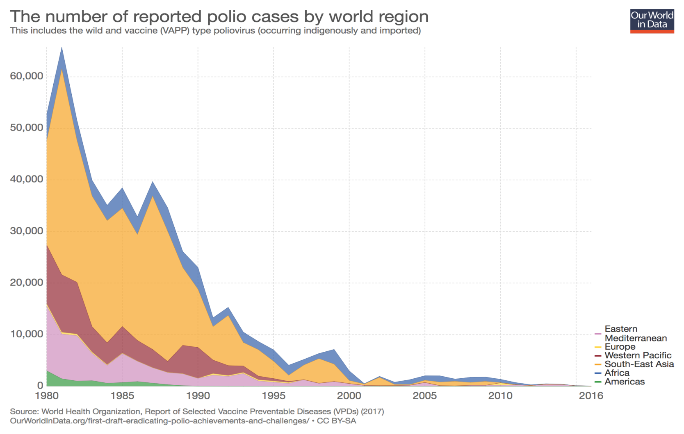
Public health benefit of vaccination
01
Vaccination greatly reduces the burden of infectious diseases (1).
Vaccination has resulted in dramatic falls in rates of many vaccine preventable diseases in the UK.
Polio
100 %
reduction (3)
Measles
99 %
reduction (4)

Slide 9
Disease reduction following NHS vaccination.

Slide 14
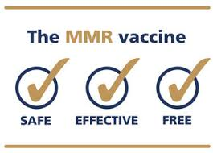
England’s uptake of MMR vaccine is among the highest in Europe.
Public Health England (PHE) experts are calling for all parents to get their children vaccinated against measles, mumps and rubella (MMR) when the vaccine is offered.
MMR vaccine is offered routinely to infants in England from 12 months of age with a second dose offered at 3 years and 4 months of age. Those who missed out will remain susceptible to the diseases, but are still recommended to get the vaccine.
The call to get vaccinated coincides with an increase in measles cases currently being seen in England.
Vaccine uptake rates in England are currently among the highest in Europe, but an increase is still needed to reach the WHO’s 95% target for MMR vaccination in 2 year olds.
PHE urges parents to vaccinate against measles, mumps and rubella

Slide 15
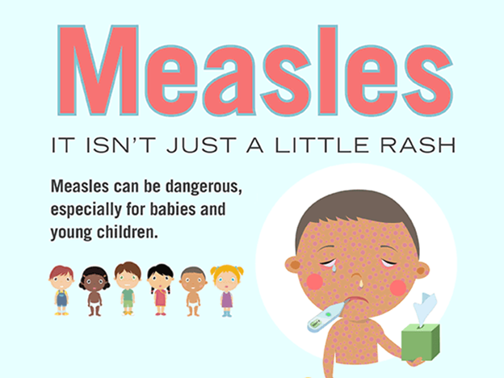
Approximately 24,000 children in England every year (2,000 a month) are not currently receiving MMR vaccination at the scheduled time (from 12 months of age) and remain susceptible to the diseases the vaccine protects against.
Measles is a highly infectious viral illness that can be very unpleasant and sometimes lead to serious complications. Although usually a mild illness in children, measles can be more severe in adults.
Two doses of MMR vaccination also provides protection against two other common highly infectious diseases: mumps and rubella.
Dr Mary Ramsay, Head of Immunisation at PHE said:
“We’re asking parents, young people and healthcare professionals to help us eradicate measles in this country. Before a vaccine was available, hundreds of thousands caught measles and around a hundred people died each year. But now, the whole community benefits from the herd immunity that the safe and effective MMR vaccination offers – fewer people get ill and the disease’s spread is restricted.

Slide 16
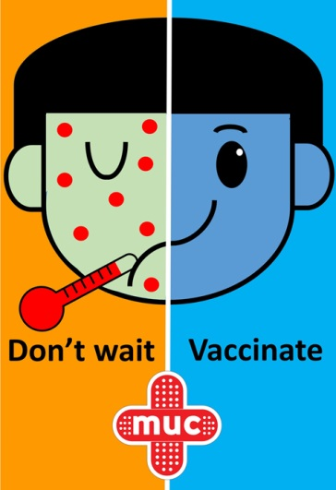
“Following the introduction of the measles vaccination in 1968, the number of cases dropped dramatically and deaths from measles are now extremely rare. That number could fall even further if more people get vaccinated.
“The cases we are seeing currently in England are being confirmed mainly in adolescents and young adults, and it’s never too late for them to have the vaccine.
“Public Health England asks that parents and young adults remain alert to measles.
Signs can include:
cold-like symptoms
sore red eyes
high temperature
red-brown blotchy rash
Those experiencing symptoms should seek medical attention, but phone ahead before visiting GP surgeries so arrangements can be made to prevent others from being infected.
“It’s crucial pregnant women have been vaccinated with MMR as rubella in particular can cause serious complications during pregnancy. The MMR vaccination provides you and your baby important protection and can be given before you become pregnant or after you’ve given birth. Pregnant women who are unsure if they’ve been vaccinated should check with their GPs.

Slide 17
Background information
1.Public Health England exists to protect and improve the nation’s health and wellbeing, and reduce health inequalities. It does this through the delivery of specialist public health services.
2.Coverage of the first dose of MMR vaccine in the UK is high among infants, with more than 90% of children receiving 1 dose of the vaccine by 2 years of age since 2011.
3.Latest figures show that the uptake of MMR vaccine in Wales, Scotland and Northern Ireland reaches the WHO’s 95% target for 2 year olds.
4.Vaccination for measles was introduced into the UK in 1968, with rubella vaccine for teenage girls in 1972. In 1988, the first combined vaccine for mumps, measles, and rubella – the measles-mumps-rubella (MMR) vaccine was introduced.
5.People who have not been fully vaccinated (had 2 doses of the MMR vaccine) or haven’t had the infection before – particularly those who are immunosuppressed, pregnant or infants – should see their GP.
6.Women of childbearing age, should be immune to rubella as this infection can have serious complications in pregnancy. Any women unsure of their MMR immunisation status should seek advice from their GP but wait one month after the last dose of MMR before becoming pregnant. As the vaccine cannot be given in pregnancy, post-natal women should check their MMR immunisation status with their GP at their 6-week maternal check.

